Slide 1
CHAPTER FOUR
SYSTEM DESIGN

Slide 2
4.1 Overview of System Design
4.2 Design Goals or purpose of system design
4.3 Architecture of System Design
4.3.1 Architectural Style
4.3.2 System Process
4.3.3 System Decomposition
4.3.3.1 Subsystem Description
4.3.4 Hardware/Software Mapping
4.4 Object Oriented Class Diagram
4.5 Collaboration Modeling

Slide 3
4.6 Component Modeling
4.7 Deployment Modeling
4.8 Database Design
4.8.1 Conceptual Database Design
4.8.2 Logical Database Design
4.8.3 Physical Database Design
4.9 User Interface Design
4.10 Access Control
4.11 Algorithm Design

Slide 4
4.1 Overview of System Design
Write short description what you are going to done at this part.
This part of the project includes: Design Goals, System Architecture such as Architectural Style, System Process, System Decomposition and system design models such as Object Oriented Class diagram, Collaboration Modeling, Component Modeling, Deployment Modeling, Database Design, User Interface Design
It is also include the Access control and Design of the Algorithm

Slide 5
4.2 Design Goals
Write short description about the design goals of the system

Slide 6
4.3 Architecture of System Design
4.3.1 System Architecture
Write Short description about the type of architecture or architectural style you select for the development of the proposed system.
Consider both the hardware and software architecture and show graphically to show the interaction between the layers of the architecture.
4.3.2 System Process
Write a short description about the system process at the system design level

Slide 7
4.3.3 System Decomposition
Describing the subsystem decomposition in terms of:
Subsystem responsibilities,
Dependencies among subsystems,
Subsystem mapping to hardware, and
Major policy decisions such as control flow, access control, and data storage

Slide 8
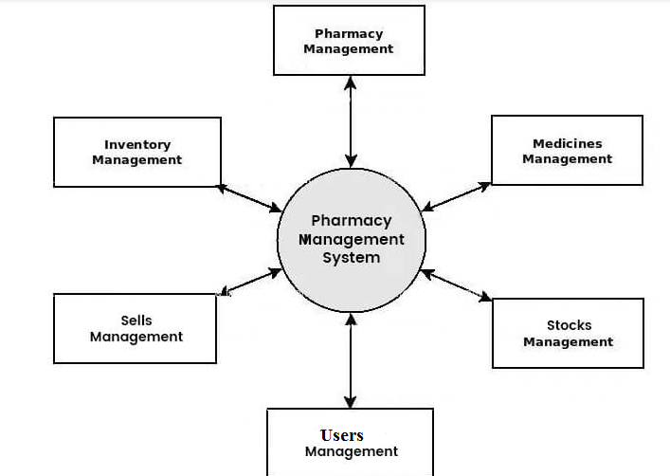
4.3.3.1 Subsystem Decomposition
Write short description about the subsystem decomposition of the system you developed.
Show graphically the decomposition of the subsystem. Use DFD for your graphical representation.
Example: The following is a subsystem decomposition for pharmacy management system

Slide 9
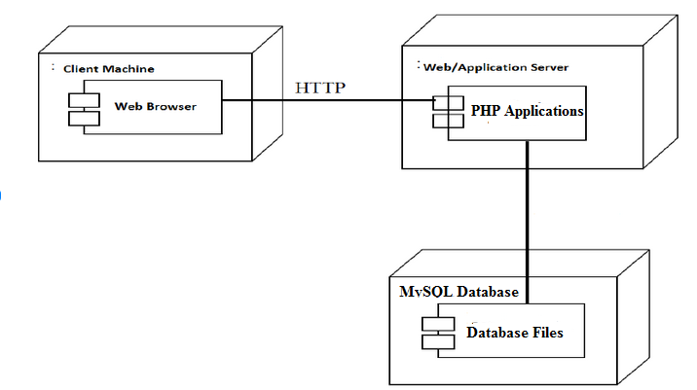
4.3.4 Hardware/Software Mapping
Describe about the hardware/software mapping of your system shortly and use graph for the hardware/software mapping of your system based on the nature your programming or scripting language and Database used for the development.
For example the following is the hardware/software mapping for pharmacy management system

Slide 10
4.4 Object Oriented Class Diagram
Write short description about object oriented class diagram at the design phase by considering what makes this class diagram is different from the class diagram at analysis phase.
Show graphically the object oriented class diagram.
The class model at the design level will add some additional details than that of the analysis level class model.
The design level class model will concentrate on how to implement:
Attributes,
Methods,
Relationships(inheritance, association, aggregation, composition and the likes).

Slide 11
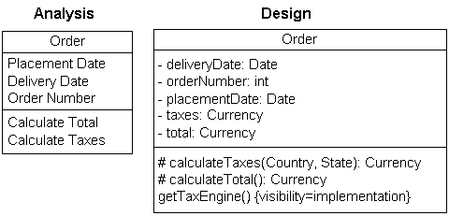
The following is an example to compare Analysis and design versions of a class diagram
Analysis Level | Design Level

Slide 12
4.5 Collaboration Modeling
Write short description about collaboration modeling by considering the source of information and what makes this model is different from sequence diagram.
Collaboration Diagrams show the same information as a sequence diagram. Semantically similar. But
A collaboration diagram emphasizes the relationship of the objects that participate in an interaction.
But it don’t have to show the lifeline of an object explicitly in a collaboration diagram.
Show graphically some of the collaboration diagram with few explanation.

Slide 13
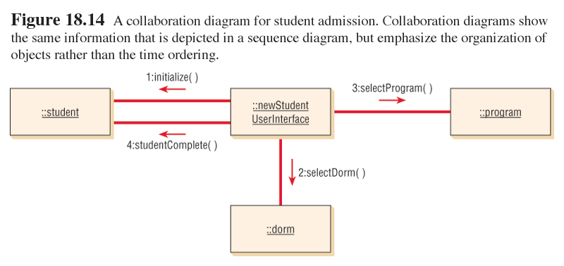
Collaboration Diagram Example

Slide 14
4.6 Component Modeling
Write Short description about the use of this modeling to design the proposed system.
Model the components to represent the different high-level reusable parts of a system and also to captures the inter-relationships between these parts
Use the UML graphical representation to model the components or applications of the system you developed.
The following graph in the next slide is a sample Component diagram for pharmacy management system:

Slide 15
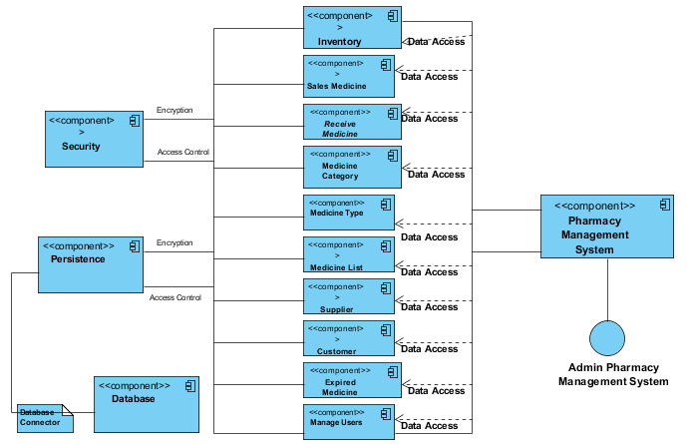

Slide 16
4.7 Deployment Modeling
Write Short description about this model to design the proposed system.
Use the UML graphical representation to model the deployment diagram of the system.
The following graph in the next slide is a sample Deployment diagram for pharmacy management system:

Slide 17
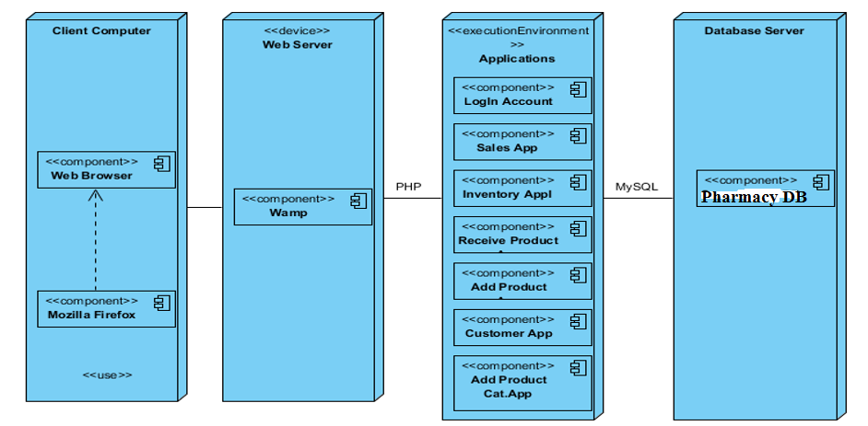

Slide 18
4.8 Database Design
Write short explanation about the database design.
4.8.1 Conceptual Database Design
Describe the conceptual database design shortly and show the design using ER-Diagram

Slide 19
4.8.2 Logical Database Design
Describe the logical database design shortly and show the design using Relational Database model
4.8.3 Physical Database Design
Describe the physical database design or the physical realization of the data in the database shortly and show the design in tabular form to represent how data is physically represented in the computer.

Slide 20
4.9 User Interface Design
Write short description about user interface design in the design phase of system development life cycle.
Show all the UI of your system graphically including Home Page or LogIn screen and other basic UI screen of your system as part of your document.
The following is a sample UI diagram used as a Home Page for pharmacy management system:

Slide 21
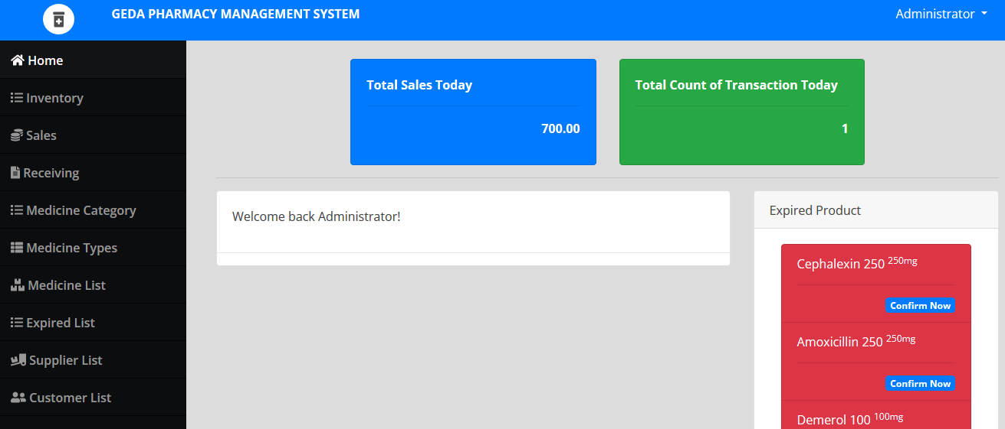

Slide 22
4.10 Access Control
Write short description about the access control mechanism you design for your system by giving examples.

Slide 23
4.11 Algorithm Design
Write short description about the importance of the algorithm design for the proposed system and the tool you are using to show the design of the algorithm .
Example:
The following is the pseudocode program for Method Name=login() and logout()
PSEUDO CODE FOR LOGIN
Step
Method name =login
Begin
Variables: - Username, password

Slide 24
Read username & password,
check against database
If they’re correct {
create pseudo-random session ID
Store session ID on database
Return session ID in cookie
Cookie lasts 1 hour
Session ID on database lasts 1 hour (script for removal?)
End if
}
Else { user is not logged in,gets view privilege only checking
To be done before any admin action

Slide 25
Read session from cookie
End if
}
If session exists on database{
user is logged in, gets admin privilege
End if
}
Else {
user is not logged in, gets view privileges only –try to delete cookie
End if
}
END

Slide 26
PSEUDO CODE FOR LOGOUT
Step
Method name =logout
Begin
Variables: - session ID, cookie
Delete database session
Try to delete cookie
End

Slide 27
activity diagram
state diagram
component diagram
ui
cover and table of contents

